Slide 1
AL Drama and Theatre
Mrs Millington

Slide 2
Pearson/Edexcel
https://qualifications.pearson.com/en/qualifications/edexcel-a-levels/drama-and-theatre-2016.html

Slide 3
Yasmine
Year 13

Slide 4
What do I need?
GCSE Drama is not essential prior learning but you should demonstrate some passion for the subject and past drama participation
GCSE English - grade 5 or above
Energy! Commitment! Creativity! Independence! Respect! Empathy!

Slide 5
What will I study?
60% practical 40% written
in year 12
in year 13
Drama Practitioners
Devising process and application
Advanced acting skills
Movement and voice workshops
Production roles
Set play - That Face by Polly Stenham
Second play text - Antigone by Sophocles
Performance technique
Group acting and monologue exam
Devising performance and log.
Analysis of live/ digital theatre
Written paper - 2hrs 30

Slide 6
Is Drama A level right for me and my future?
YES !

Slide 7
But don't just take it from me !
Abigail
Top in the world 2015
A level Performing Arts

Slide 8
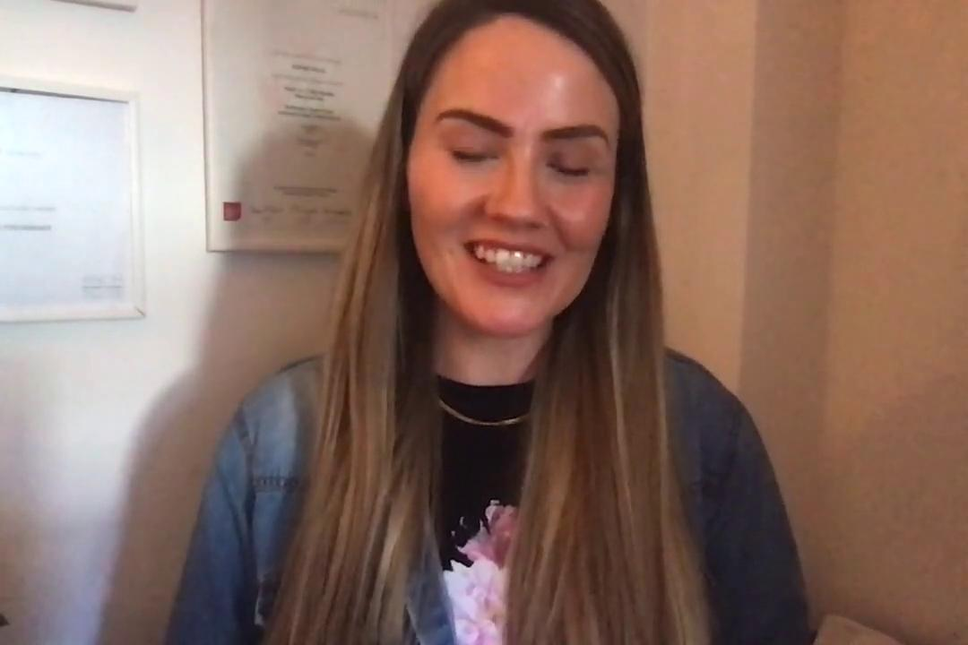
But don't just take it from me !
Sophie
Top in the world 2009
A level Drama

